Slide 1
Fixed/random Effects Analysis of Repeated Measures Data

Slide 2
Introduction
Panel data analysis and the challenge of unmeasured confounding
Fixed and random effects models for causal estimation
Objective: Explore how fixed and random effects models perform under different conditions

Slide 3
Simulation Design
Three data generating processes (DGPs):
1. Time-invariant confounding with no correlation between the confounder and treatment variable.
2. Time-invariant confounding with a correlation between the confounder and treatment variable.
3. Time-varying confounding with a correlation between the confounder and treatment variable.
Union membership and worker's wage as the research question
Four scenarios with different numbers of individuals (N) and time points (T)Panel data analysis and the challenge of unmeasured confounding:
small N and small T;
small N and large T;
large N and small T;
large N and large T.

Slide 4
Main Findings
Time-invariant unmeasured confounding with no correlation
Time-invariant unmeasured confounding with a correlation
Time-varying unmeasured confounding
Effects of N and T on fixed and random effects models

Slide 5
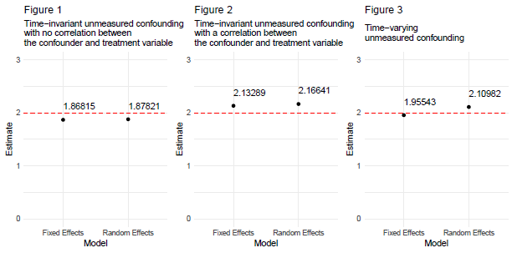
Time-invariant unmeasured confounding with no correlation
Both fixed and random effects models perform well
Random effects model is more reasonable, as it estimates the effects of time-invariant variables

Slide 6
Time-invariant unmeasured confounding with a correlation
Fixed effects model performs better
Random effects model may not fully control for confounders and can be biased

Slide 7
Time-varying unmeasured confounding
Fixed effects model cannot control for time-varying confounding
Random effects model may be biased if confounder is correlated with treatment variable
Additional techniques required, such as instrumental variables

Slide 8
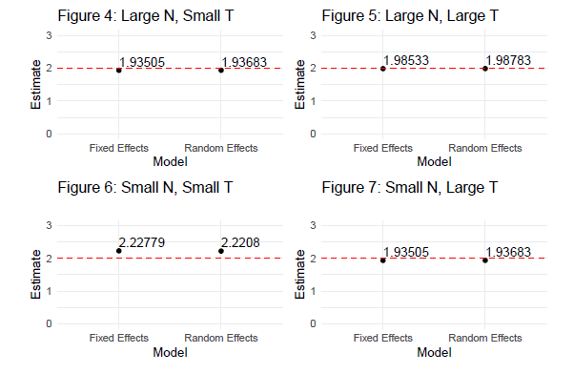
Effects of N and T on fixed and random effects models
Fixed effects model performs better in scenarios 1, 3, 4
When N and T are large, fixed and random effects models perform similarly
Random effects models are preferred when N is small and T is large

Slide 9
Conclusions
Fixed effects models: effective in controlling time-invariant unmeasured confounders, best with large N
Random effects models: more efficient and flexible when dealing with multiple time points, best with small N and large T
Complex models needed for unmeasured time-varying confounders

